Slide 1
The History of Water in Bears Ears National Monument, Southeastern Utah: Towards A Synthesis of Geochronology, Native American Oral History and Rock Art
Abbott, Morgan S. , Nofchissy, Samuel I., Bushman, Paul G., Joe, Dustin C., Gherasim, Janelle E., Campbell, Stephen R., Tulley, Skyler K, Emerman, Steven H., Hungerford, Hilary B. and Santos, Lori J
Notes:
Hi, My name is Morgan Abbott and I’m presenting our team’s current research regarding “The History of Water….”
In our project alone, we have
3 Native Students
representatives of the Pueblo and Navajo
Multiple disciplines that include
Geology
Hydrology
Environmental Science
Art Education
Botany

Slide 2
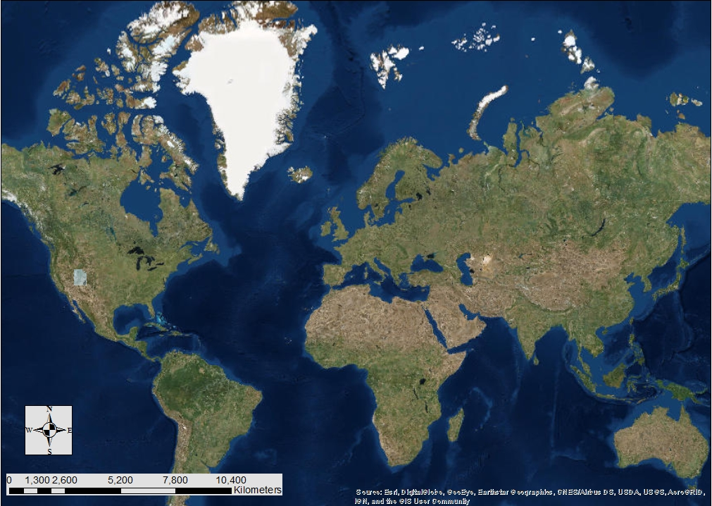
Notes:
Utah is located within the Western Hemisphere.

Slide 3
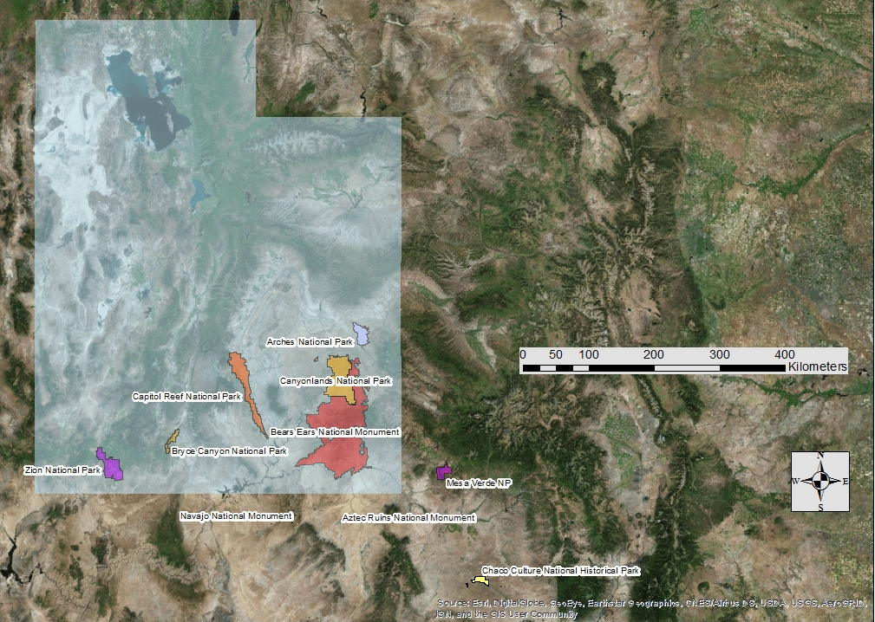
Notes:
There are 5 national parks and 3 monuments within Utah. There are multiple national parks and monuments near the four corners area where Utah, Colorado, New Mexico and Arizona meet.

Slide 4
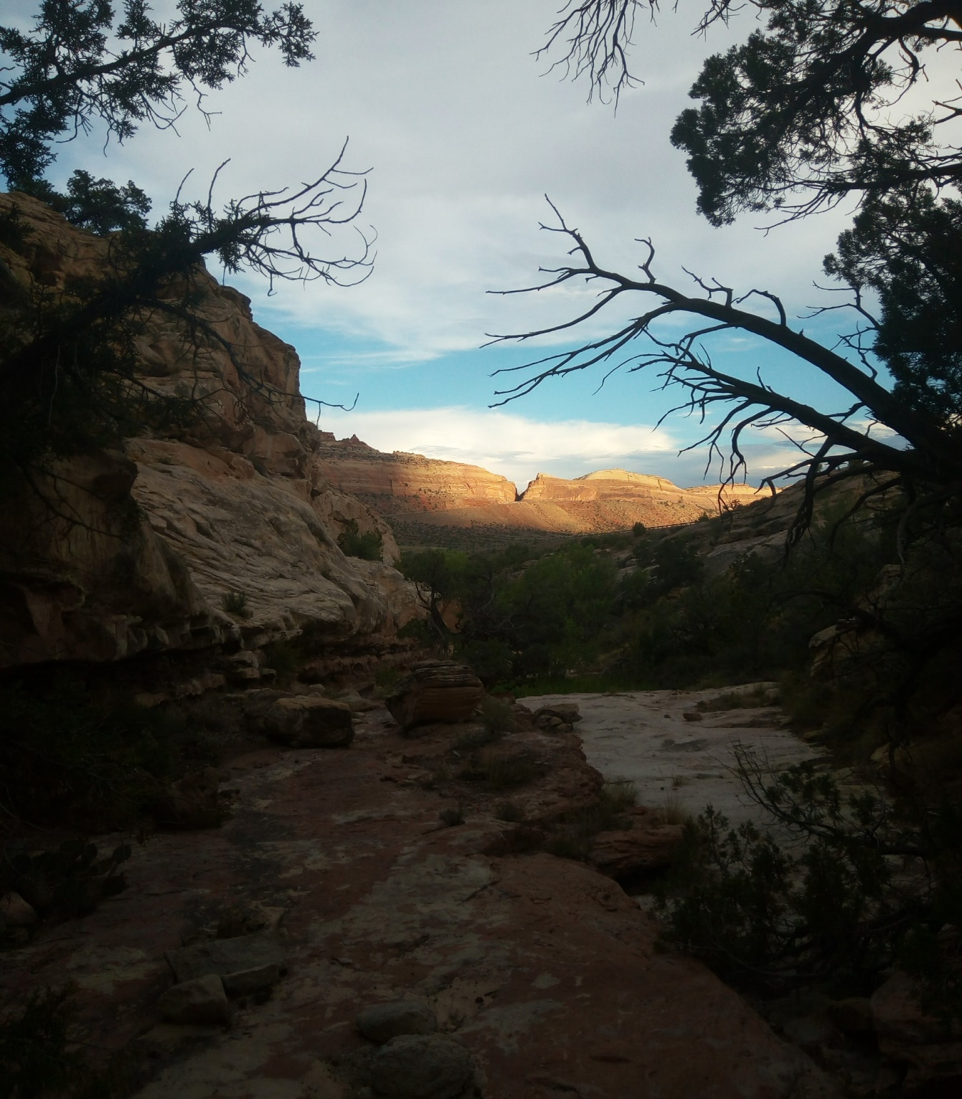
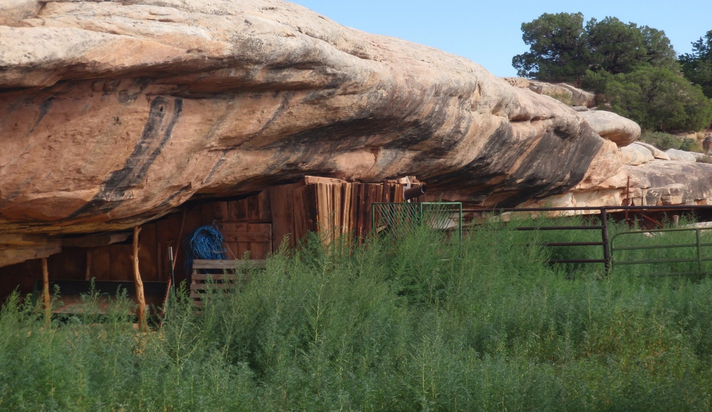
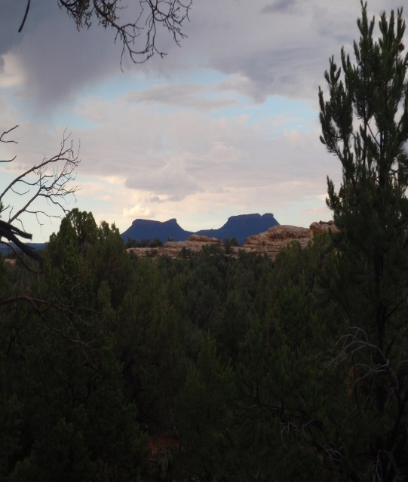
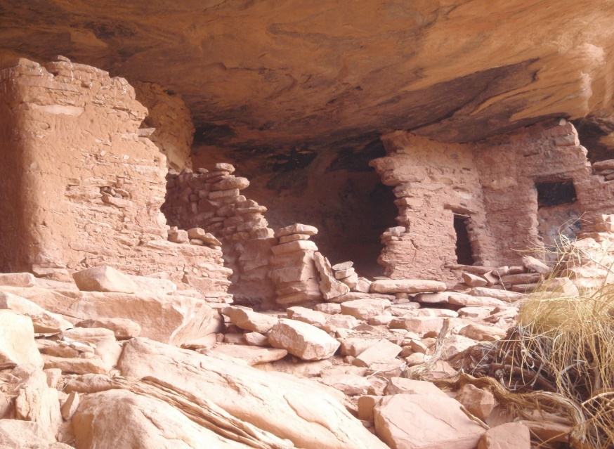
Notes:
Created December 28th, 2016 by former President Barack Obama
Secretary of the Interior Ryan Zinke recently proposed to shrink Bears Ears by 90% and it was approved by President Donald Trump December 4th, 2017
Opens up coal mining, fishing, grazing and logging (traditional uses)
Rich in historical and archaeological artifacts dating back at least 5k years, has problems with grave robbing and vandalism
Particular religious importance to Native American Tribes
Anasazi settlements
Abandoned 700 yrs ago
Managed by
U.S. Forest Service
Bureau of Land Management
Bears Ears Commission
Hopi Nation
Navajo Nation
Ute Mountain Ute Tribe,
Ute Indian Tribe of the Uintah Ouray
Zuni Tribe

Slide 5
Scope of the Project
Hydrology
What would mega-drought maps of southeastern Utah look like? That is, what water sources would persist after droughts of various durations?
On the other hand, what would the hydrography of southeastern Utah look like under increased precipitation or a change in the seasonality of precipitation?
Culture
How could the above hydrographic maps be used to interpret Native American oral histories from southeastern Utah, especially as they relate to springs?
How could the above hydrographic maps be used to interpret the rock art that is associated with springs in southeastern Utah?
Notes:
These are the questions our team is asking in our research.
I will describe Hydrology and about the current tasks we are
then we will discuss the cultural aspect of our project.

Slide 6
Hydrology
What would mega-drought maps of southeastern Utah look like?
What water sources would persist after droughts of various durations?
What would the hydrography of southeastern Utah look like under increased precipitation?
How would hydrography change in the seasonality of precipitation?
Notes:
Anasazi inhabited the four corners area, even as north as Bears Ears 700 years ago
Current hypothesis for mass migration
resulted from a boom in population
put a strain on water supplies
was worsened by a mega drought
Ancient peoples migrated to areas of persistent water sources.
Since water is life, we want to know about the impact of water regarding the Anasazi
Developing ideas how to make a megadrought map
Locating persistent water sources during a megadrought
What different amounts of precipitation would look like
How precipitation changes the hydrography

Slide 7
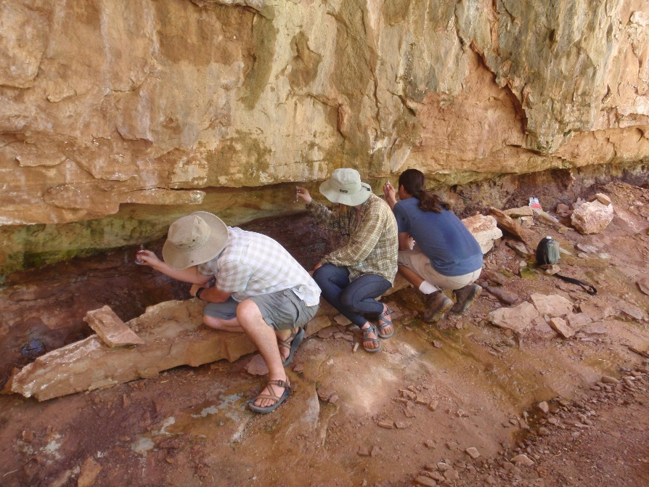
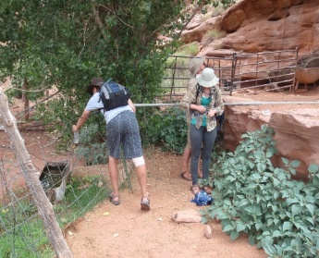
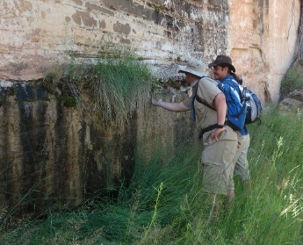
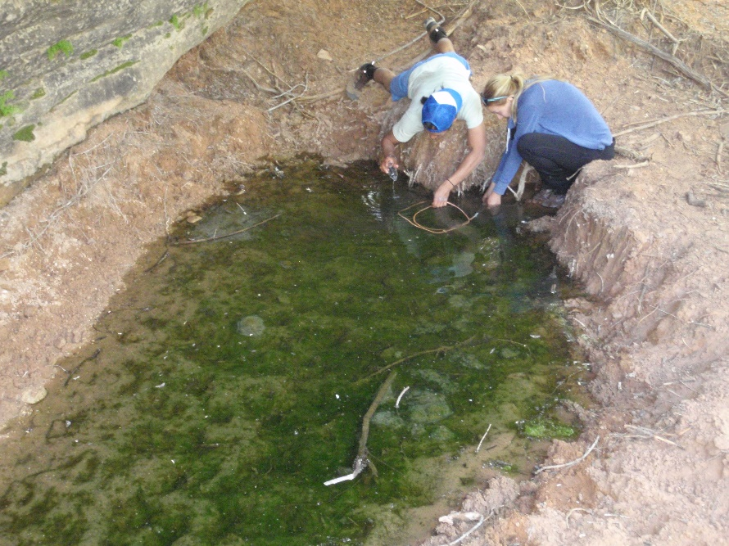
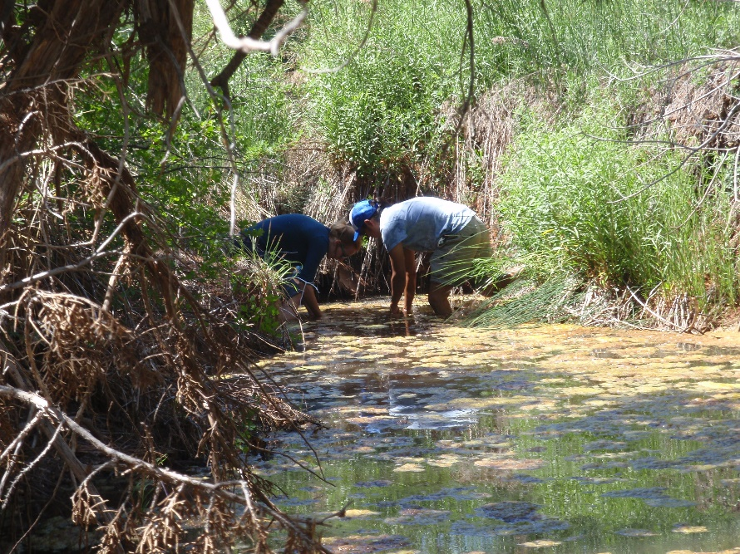
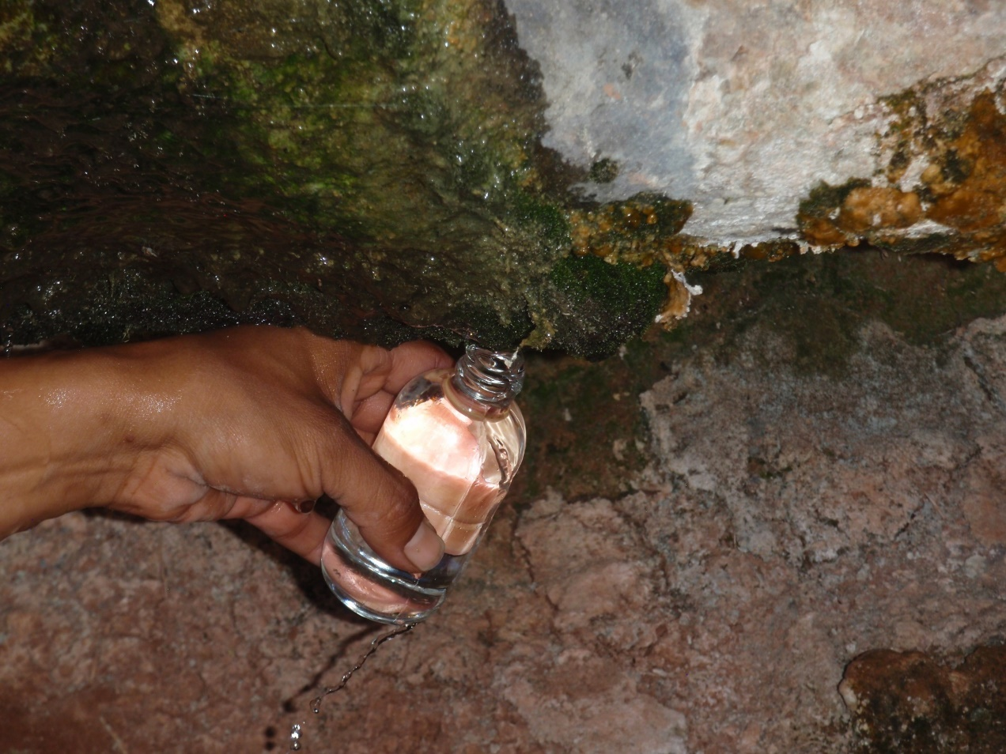
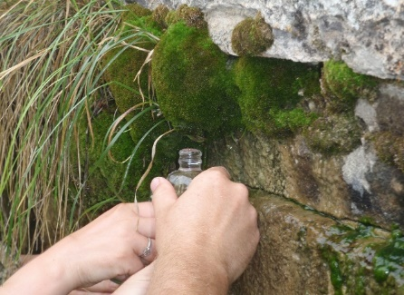
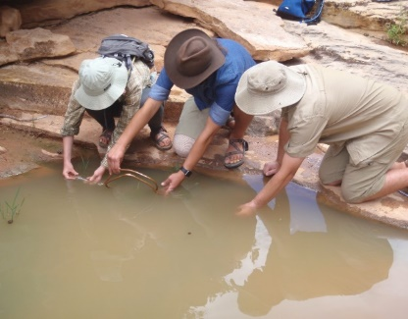
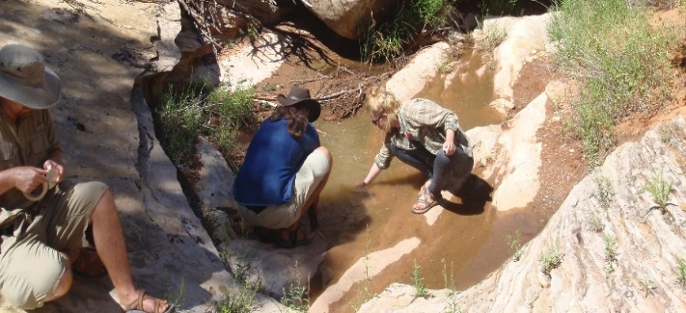
Notes:
How does this relate to our field work?
2 research teams (2015 & 2017)
Hiked around in July heat (95F) looking for puddles of water/ springs
Used small glass bottles and wrapped them in a bandana
Used glass syringe for springs large enough to collect in or just collected drops until overfilled
Collected in triplicate
Sent samples to U of U for CFC analysis (UMU 1 & 25) (BE 1-9, 11, 12, 13, 15, 16)
Performed isotope analysis at UVU

Slide 8
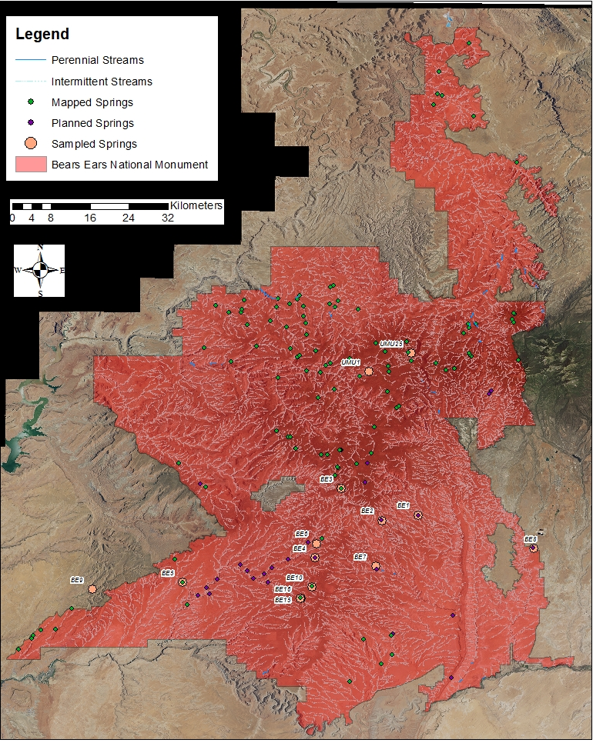
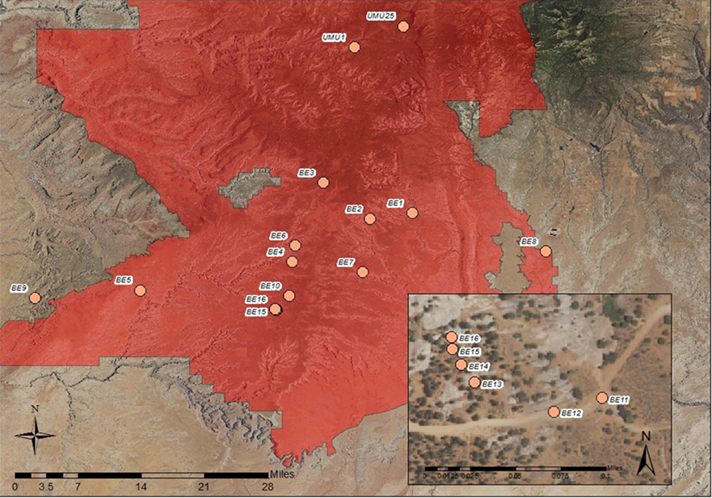
Notes:
Beginning 1st Step: Developing ideas how to make a megadrought map
Map on the left shows our sample sites named Bears Ears 1-16 and UMU 1 and 2, where they were collected in relation to the National Park Boundaries. Samples BE 11-16 are from a single spring that was a seam through a wash/canyon.
On the right the map shows our samples (same as before), potential sample sites in purple, known mapped springs in green and streams, perennial and ephemeral/intermittent. This map is a valuable tool for future research sites. We can look at perennial streams that are connected to mapped springs and see where we could sample water and look for ancient Puebloan connections to those springs.

Slide 9
Notes:
Axes are essentially showing precipitation vs evaporation
Meteoritic water line (precipitation/blue) for Bears Ears Area
Orange line are the springs that we sampled
Precipitation data was gathered from the IOPC website
We can look at this graph and see when individual samples from springs were recharged. According to this graph, snow melt doesn’t recharge the springs significantly. There are no orange sample sites near the bottom where the winter months are.
Our line (sampled springs) has a parallel shift, due to the sample BE10, which was a sample that was collected from a pool of standing water, which had high evaporation rates.
Water collected in the upper part of the graph was recently filled when we collected it, since we did field work in July.
Cluster near the bottom of graph shows that these springs were potentially recharged in the fall and spring, and that BE12 may be a persistent spring or is more long-lasting since it was recharged in November and we collected it in July.
Ultimately, the sample sites we chose were great since the majority of them follow the slope of the precipitation line, which means we picked springs and not puddles of standing water.
Potential Q
What would happen if only snow only came in, no rains?
insufficient recharge?
How many precipitation events in a year?
How would this impact human population migration
Move to perennial water sources

Slide 10
Notes:
2nd Step of Hydrology: Locating persistent water sources during a megadrought
To determine the age of the water in the springs a group went before our field collection trip and took samples from two locations.
These locations are umu 1 & 25. Results on two springs indicate groundwater residence times of 30 and 39 years, so that these springs could persist as viable water sources even after mega-droughts lasting for three decades.
We recently received CFC data regarding water samples from this summer.
BE 4 would only last about 27 years without precipitation,
BE 1-3 & 5-9 would last at least 30 years.
BE 11, 15, 16 are very close in age (27-30yrs),
BE 12 is 43 years, probably different spring
Next Step (2nd moving into 3rd): We will be using vegetation, soil, elevation and precipitation data to follow the movement of water sources from 700 AD to 1300 AD

Slide 11
Culture
How could hydrographic maps be used to interpret Native American oral histories from southeastern Utah, especially as they relate to springs?
How could hydrographic maps be used to interpret the rock art that is associated with springs in southeastern Utah?
Notes:
comparing the rock art associated with springs with shorter and longer residence times.
Going to be addressed by conversations with elders of the Ute Mountain Ute Tribe, especially with regard to the origin of the names of the springs.

Slide 12
Notes:
These are some examples of the Glen Canyon linear Petroglyph style, found in the drainages of the Colorado and San Juan rivers. These are believed to predate the Anasazi. It generally has a wider distribution farther north in Utah
Glen Canyon Linear Style.
Archaic (0AD or 6000BC) = Pre-Basketmaker

Slide 13
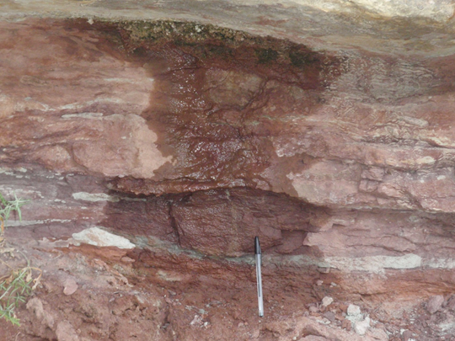
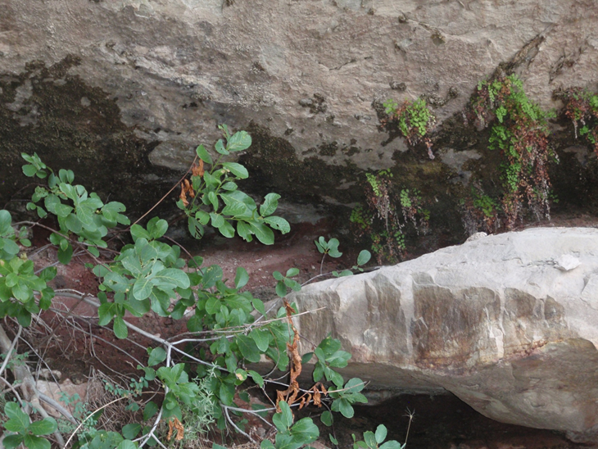
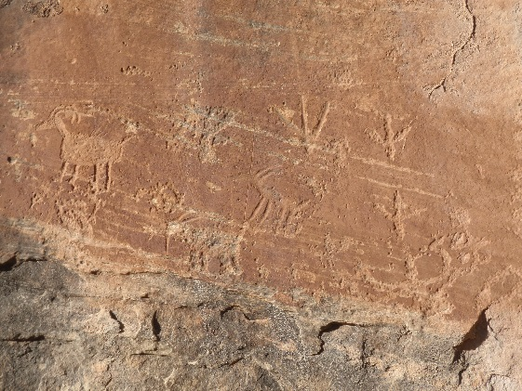
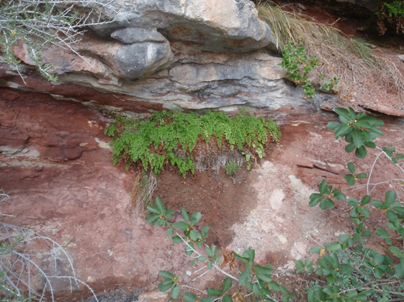
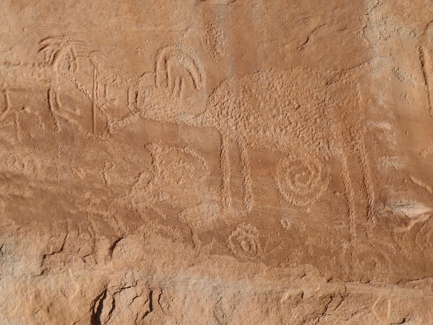
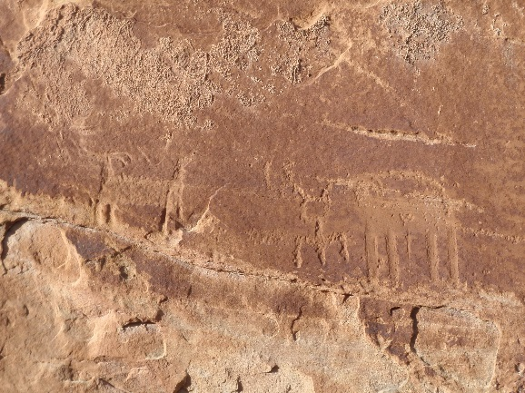
Notes:
Looking for another spring because we saw some cottonwoods way back near Butler Wash. Decided to check it out. Found huge panel, ruins and spring. These are some of the clearer images of the petroglyphs we found

Slide 14
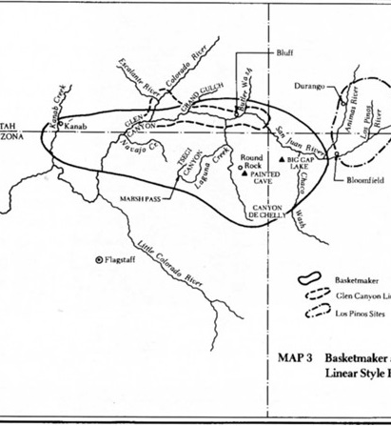
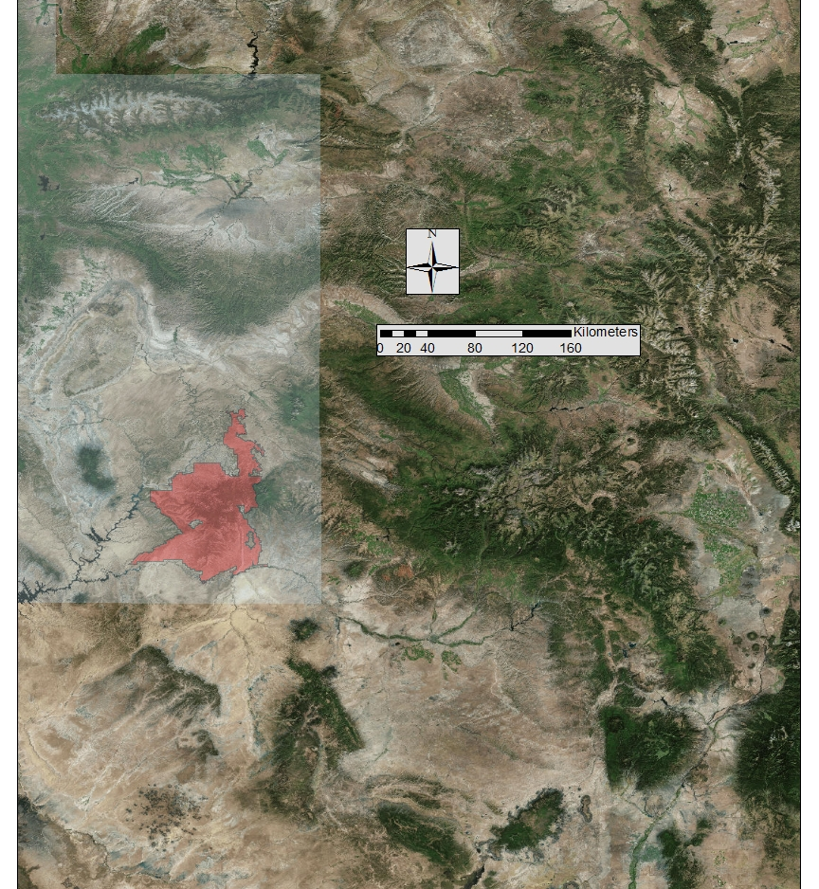
Notes:
Where these petroglyphs are found in relation to bears ears
The map on the left is from the book “Indian Rock art of the Southwest” by Polly Schaafsma

Slide 15
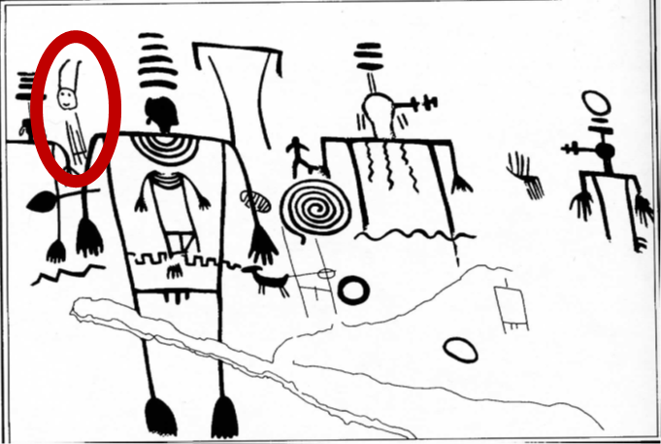

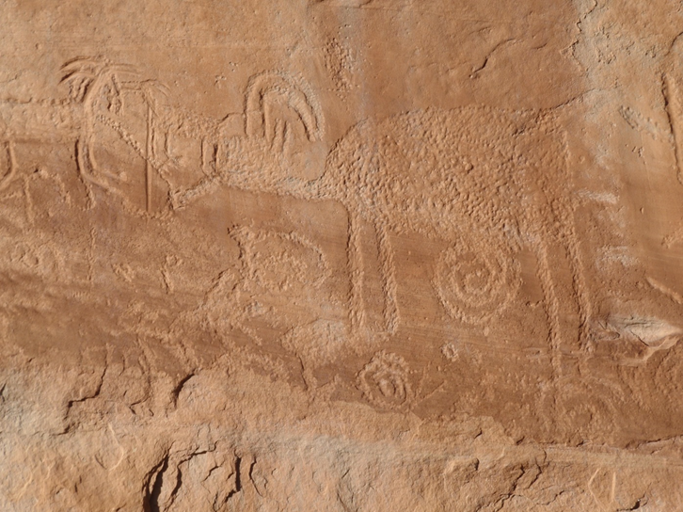
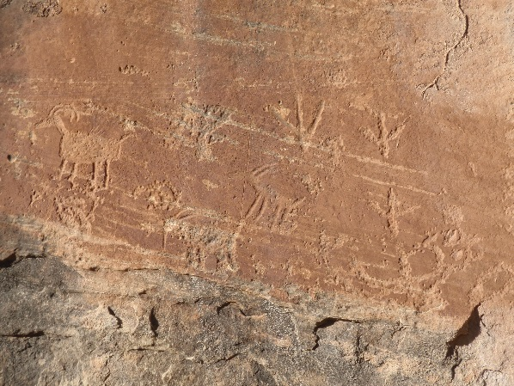
Notes:
Usually mountain sheep or deer. Large rectangular oval bodies with small heads and tails, short legs.
Drawings found near water sources, campsites, some consider to be hunting-magic related or just lots of people gathered in an area with lots of movement between
Antennae are part of the anthropomorph drawings, concentric images above head refers to shaman
As referenced in the previous slide, usually found with Basketmaker II, hard to date, but some patina is still dark in areas, suggests that it older petroglyphs were pre-pottery.
Glen Canyon Linear Style
Archaic (0AD or 6000BC) = Pre-Basketmaker
Images and info from “Indian Rock art of the Southwest” by Polly Schaafsma

Slide 16

Notes:
Conclusions
Winter snowpack is less vital to recharge springs than spring and fall precipitation
We can begin examining our current data and plan future field excursions to ask more specific questions about the springs that are near perennial streams
Provides new insight to cultural and hydrological history
unnamed spring with the panel
Documenting this is important due to climate change and increased visitation

Slide 17
Acknowledgements
Dr. Alessandro Zanazzi, Associate Professor –Earth Science, UVU
Erin Riggs, UVU Herbarium Curator
Funding provided by
SAC grant applied for by Steven Emerman and Hillary Hungerford
UCUR grant provided by UVU Scholarly and Creative Activities Council
Notes:
Our research team would like to thank Dr. Zanazzi for his assistance in processing our water samples for isotope data, Erin Riggs- Herbarium Curator for assisting us in identifying plants, Dr. Emerman and Dr. Hungerford for securing funding through UVU SAC grants and we would also like to thank the UVU Scholarly and Creative Activities for providing a UCUR grant to continue our research
Sources Cited
http://eds.a.ebscohost.com/eds/detail/detail?vid=6&sid=dd1f8564-2878-41a2-940e-aa2147032845%40sessionmgr4010&bdata=JnNpdGU9ZWRzLWxpdmU%3d#AN=122710916&db=asf
Bowen, G. J. (Year) The Online Isotopes in Precipitation Calculator, version X.X. http://www.waterisotopes.org
Monthly: Bowen G. J., Wassenaar L. I. and Hobson K. A. (2005) Global application of stable hydrogen and oxygen isotopes to wildlife forensics. Oecologia 143, 337-348, doi:10.1007/s00442-004-1813-y. (for monthly average values)
Welker J.M., 2000. Isotopic (d18O) characteristics of weekly precipitation collected across the USA: An initial analysis with application to water source studies. Hydrological Processes 14, 1449-1464.
Photos of Bears Ears Trip courtesy of Dr. Steven Emerman & Morgan Abbott
https://md.water.usgs.gov/posters/flowGIS/index.html
“Indian Rock art of the Southwest” by Polly Schaafsma
Map features, raster and vector data sourced from Esri
(ArcGISOnline), Utah AGRC, NDH Streams
https://geology.utah.gov/map-pub/maps/gis/#tab-id-3

